Slide 1
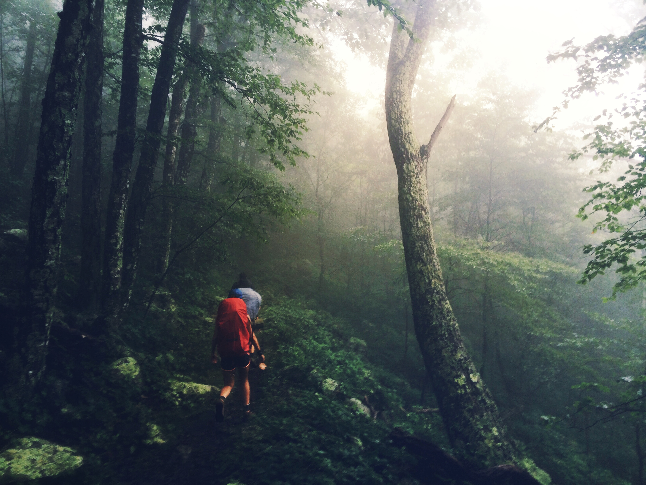
CURIOSITY
PROJECT
THE
“It was something most people forgot as they grew into adults.”
– Robert McFarland
Daniel Choi – University Honors Program

Slide 2


BACKGROUND
METHODS
A priori hypothesis: curiosity and wonder do not have to be lost in adulthood, but can be retained and nurtured
I reviewed scientific and popular literature.
I interviewed individuals about the role curiosity and wonder have played in their lives.
I collected first person narratives detailing personal experiences of curiosity and wonder.
Curiosity vs. Wonder
Curiosity
Wonder
Event of Experience
Approach in Primary Research
Curiosity
Wonder
Approach in Popular Literature
Curiosity
Wonder
Notes:
Curiosity is an information-seeking behavior leading to an experience. Wonder is a reaction to an experience. Scientific literature often views curiosity and wonder individually, studying their mechanisms. Popular literature approaches them together, describing their collaborative function in our lives.

Slide 3
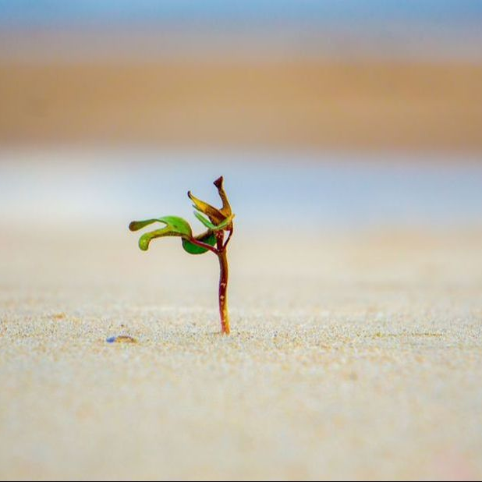


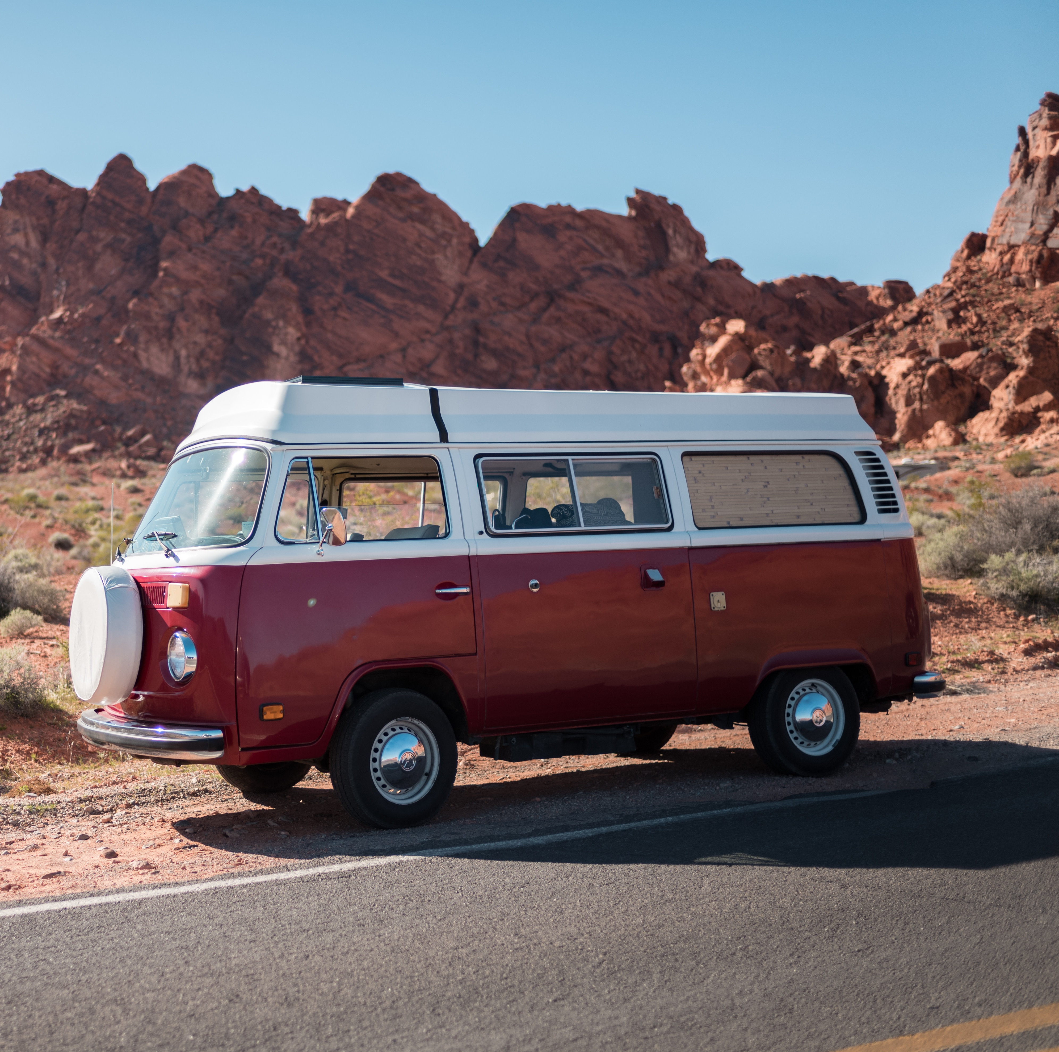

“I love walking around outside, finding things, and seeing them in ways that others may not see them.”
- Bryanna, Photographer
“I encourage you to stop, and let your gaze drift along with the waves. If you do, I guarantee you’ll get a small taste of the amazing world I try to immerse myself in every single day.”
- Iman, Researcher, Fish Enthusiast, Baker, Student
RESULTS
Narratives of Curiosity and Wonder
“It can be a challenge to have a sense of wonder. As we grow older, we lose the appreciation and the magic of things around us that may have filled us with curiosity and child-like amazement in the past.”
- Nathan
“We have exposure to glorious beauty even in the most ordinary settings, and I think that’s magnificent.”
- Katie, Campaign Marketer
“We have the power, and the inherent decision to make as to whether or not our curiosity will multiply or be silenced.”
- Peter, Follower of Jesus, Husband, Dad

Slide 4
Curiosity and wonder are good, beneficial, and enjoyable. They begin in childhood as innocent, open, and pure characteristics. Further, they are necessary.
1
Modern culture is against you. In adulthood, curiosity and wonder easily decay, become incomplete, or seem to disappear completely.
THEMES
2
Curiosity and wonder must interact together. They begin inside you, not in you surroundings. Slow down, search for beauty, and make the decision to develop your curiosity and wonder.
3

Slide 5
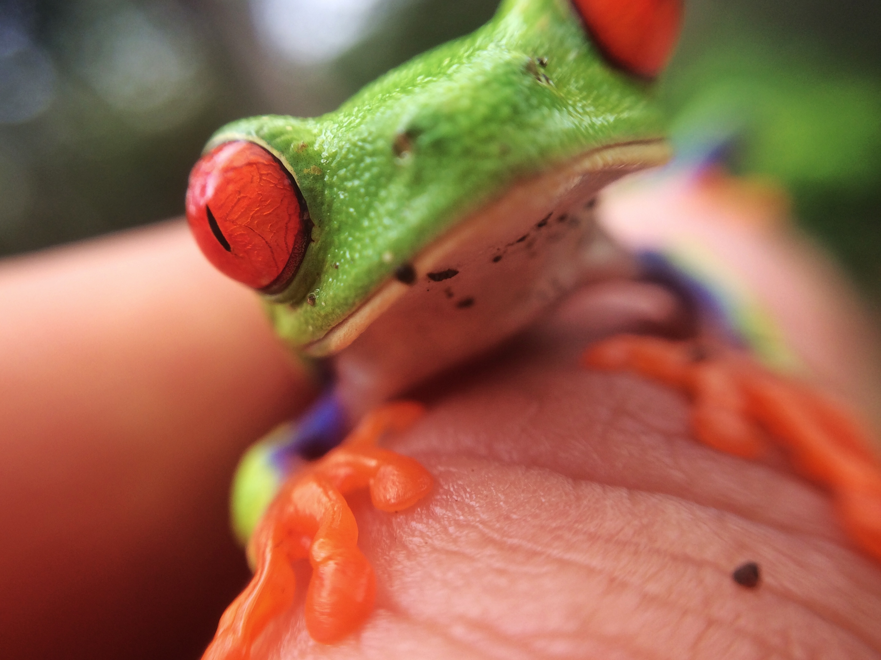
“But how exactly do you ask someone to be curious?”
– Marco Livio
Notes:
When matured, curiosity and wonder are gifts which allow us to uncover beauty and value in places where they appear absent. We can do this by accepting that the curiosity and wonder we experience is our personal responsibility and need not be dependent on our surroundings. When something does not quickly cater to your curiosity and wonder, do not assume you cannot see its beauty. Be generous with your curiosity. Give too much wonder, rather than too little. Begin today with this: What is something you have always wondered about, but have never taken time to ponder?

